Slide 1
DATA STRUCTURES
Expression Tree

Slide 2
Session Objectives
To learn Expression Tree
Notes:
Student Notes:
The objective of the session is to introduce the concept of services and how these are management. There are standards and frameworks that enable the organization to manage the services. These are also introduced in this session.

Slide 3
Session Outcomes
At the end of this session, participants will be able to
Understand the implementation and construction of tree

Slide 4
Agenda
Implementation and construction of Expression Tree

Slide 5

Expression Tree
Dr. B. Prabavathy
SSNCE

Slide 6
What is an Expression Tree?
Expression tree is a binary in which each leaf node represents operands and internal nodes represent operators
Traverse the Expression Tree
Inorder Traversal – we will get infix expression
Preorder Traversal – we will get prefix expression
Postorder Traversal – we will get postfix expression

Slide 7
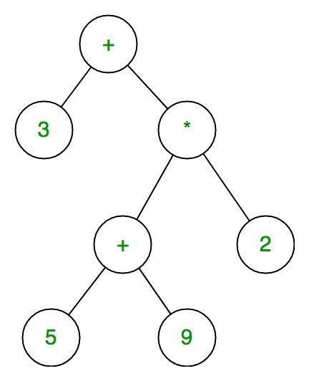
Expression Tree
What is the use of Expression Tree?
Expression trees represent code in a tree-like data structure, where each node is an expression
Example for Expression Tree

Slide 8
Construction of Expression Tree - Algorithm
For constructing expression tree we use a stack
Input for the construction is postfix expression
For every character in the postfix expression 1) If character is an operand, create a leaf node whose value is the operand and whose left and right subtrees are null. Push the address of the node into the stack 2) If character is an operator, create a new node with the operator as its value
Pop the two child nodes from the stack and attach them to the new node
The first child popped from the stack becomes the right subtree of the new node and the second child popped from the stack becomes the left subtree. Push the address of the new node

Slide 9
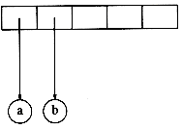
Expression Tree Construction Example ab+cde+**
Characters ‘a’ and ‘b’ are read from the array and they are operands, the nodes of ‘a’ and ‘b’ are created
The addresses of a and b are pushed into the stack

Slide 10
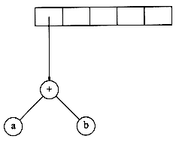
Expression Tree Construction Example ab+cde+**
Character ‘+’ is read, node will be created for ‘+’
First popped value is ‘b’. Attached as right of node ‘+’
Second popped value is ‘a’, Attached as left of node ‘+’
Address of ‘+’ is pushed into the stack

Slide 11
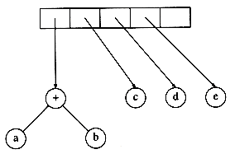
Expression Tree Construction Example ab+cde+**
Characters ‘c’, ‘d’ and ‘e’ are read from the array and they are operands, the nodes for ‘c’,’d’ and ‘e’ are created
The addresses of c, d and e are pushed into the stack

Slide 12
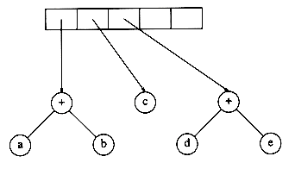
Expression Tree Construction Example ab+cde+**
Character ‘+’ is read, node will be created for ‘+’
First popped value is ‘e’. Attached as right of node ‘+’
Second popped value is ‘d’. Attached as left of node ‘+’
Address of ‘+’ is pushed into the stack

Slide 13
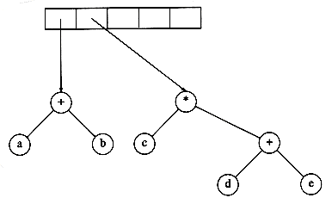
Expression Tree Construction Example ab+cde+**
Character ‘*’ is read, node will be created for ‘*’
First popped value is address of the ‘+’. Attached as right of ‘*’
Second popped value is ‘c’. Attached as left of node ‘*’
Address of ‘*’ is pushed into the stack

Slide 14
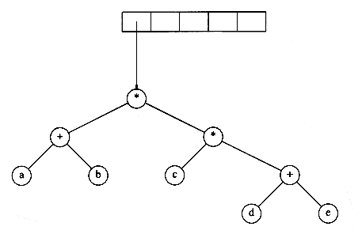
Expression Tree Construction Example ab+cde+**
Character ‘*’ is read, node will be created for ‘*’
First popped value is address of the ‘*’. Attached as right of node ‘*’
Second popped value is ‘+’. Attached as left of node ‘*’
Address of ‘*’ is pushed into the stack

Slide 15
Simple questions
What is an Expression tree?
Where ET is useful?

Slide 16
Summary
Implementation and Construction of Expression Tree

